Slide 1
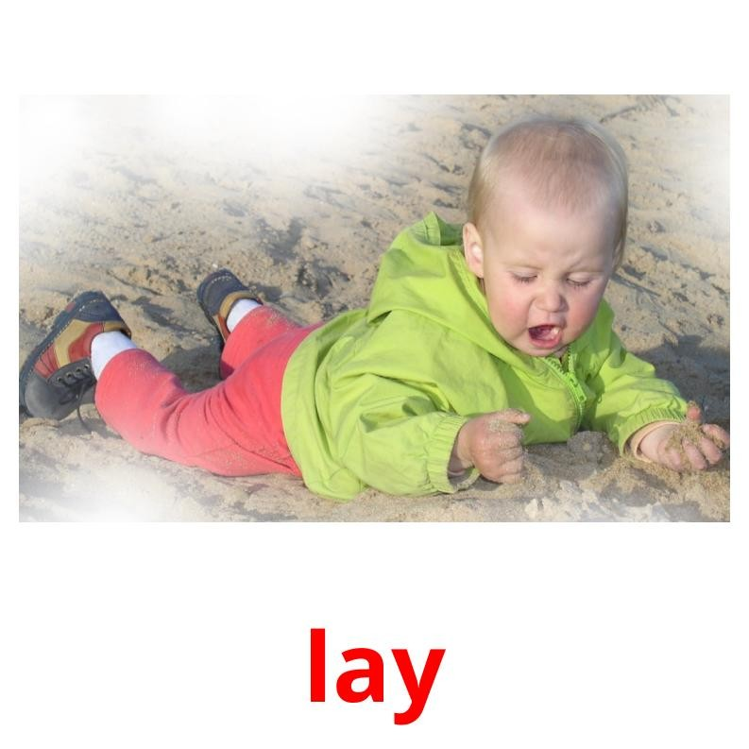
Action verbs - made by Kids-Flashcards.com

Slide 2
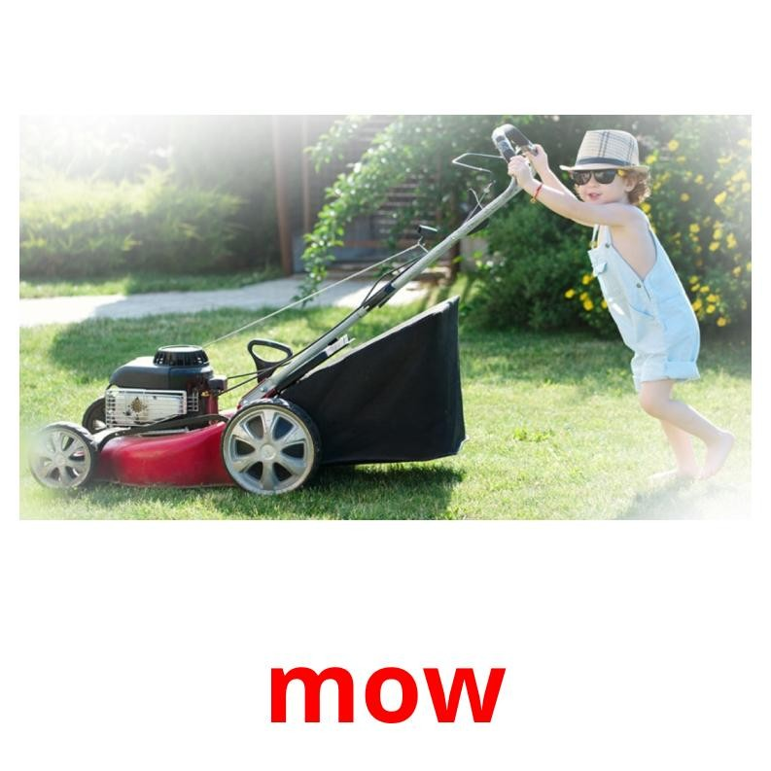
Action verbs - made by Kids-Flashcards.com

Slide 3
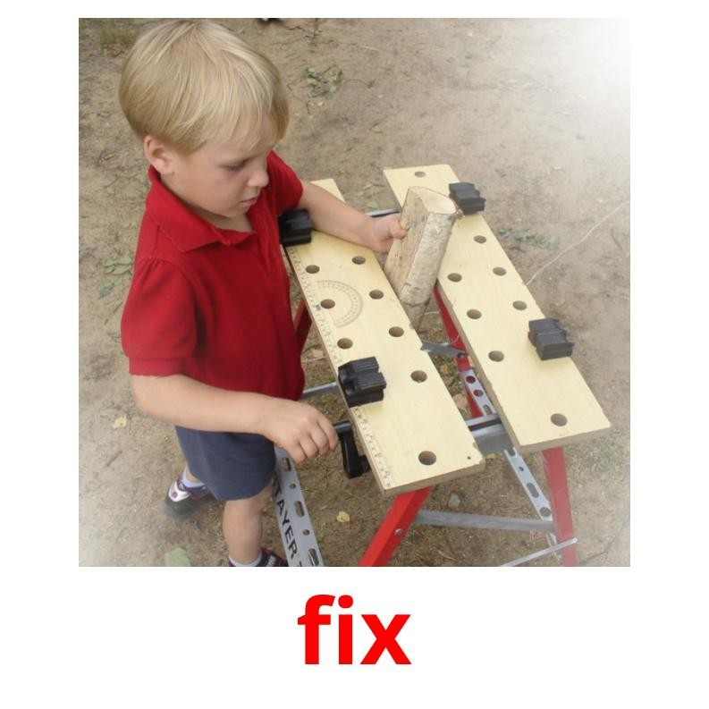
Action verbs - made by Kids-Flashcards.com

Slide 4
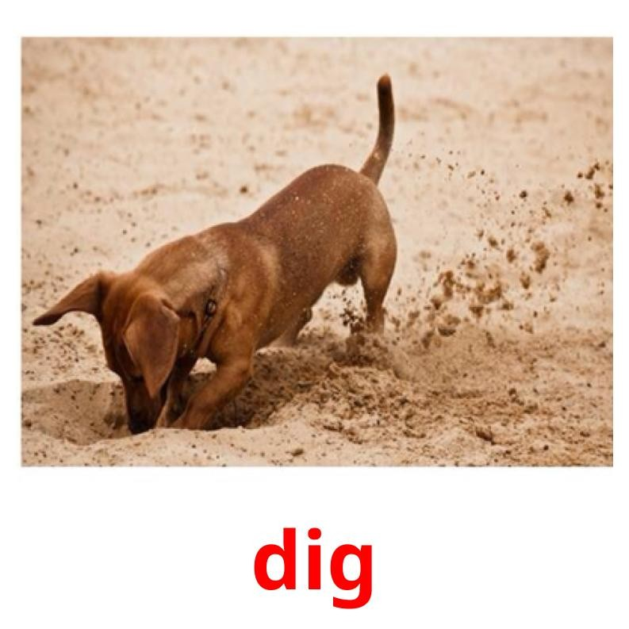
Action verbs - made by Kids-Flashcards.com

Slide 5
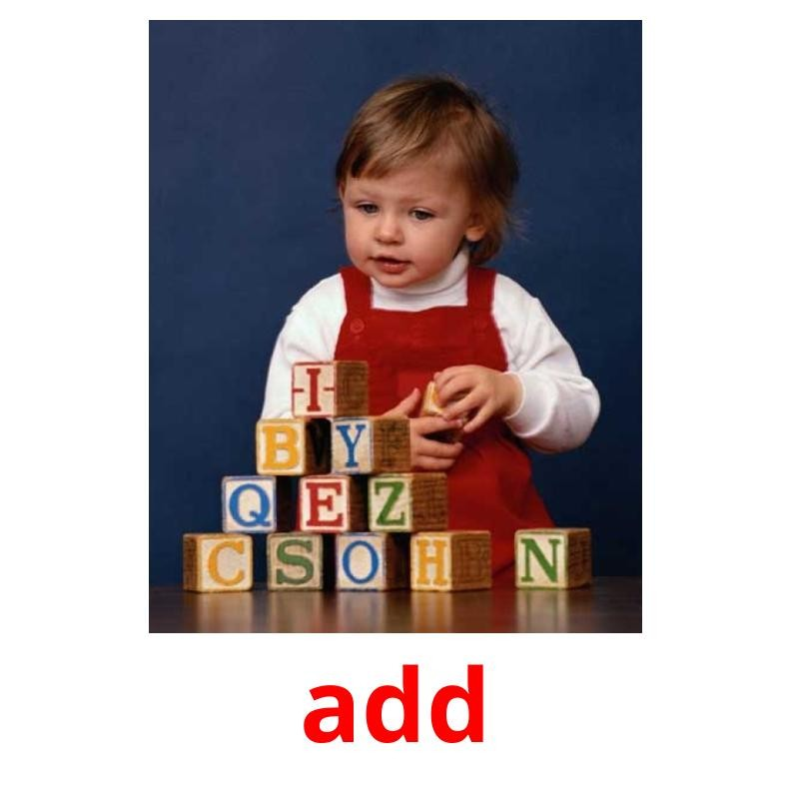
Action verbs - made by Kids-Flashcards.com

Slide 6
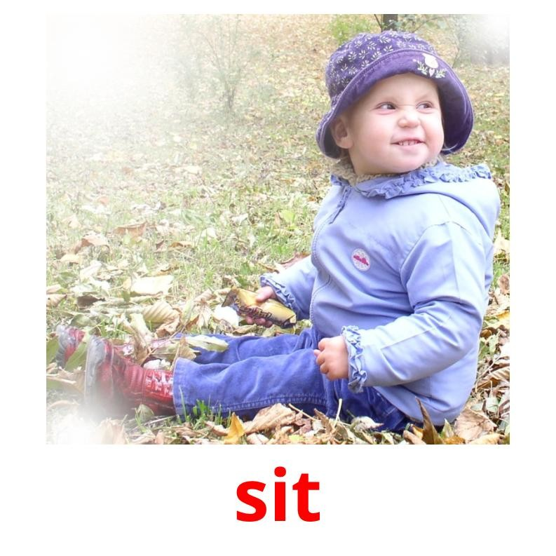
Action verbs - made by Kids-Flashcards.com

Slide 7
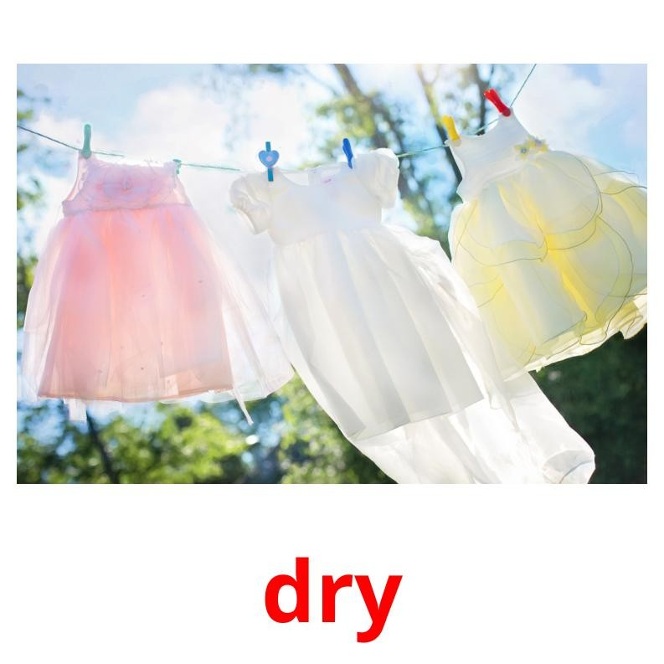
Action verbs - made by Kids-Flashcards.com

Slide 8

Action verbs - made by Kids-Flashcards.com

Slide 9
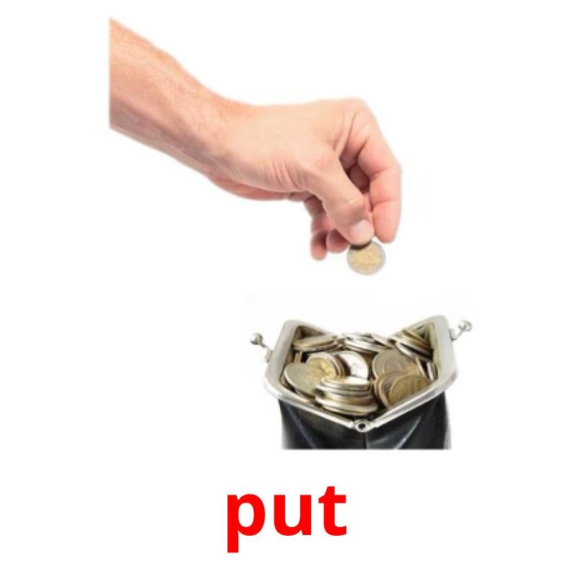
Action verbs - made by Kids-Flashcards.com

Slide 10
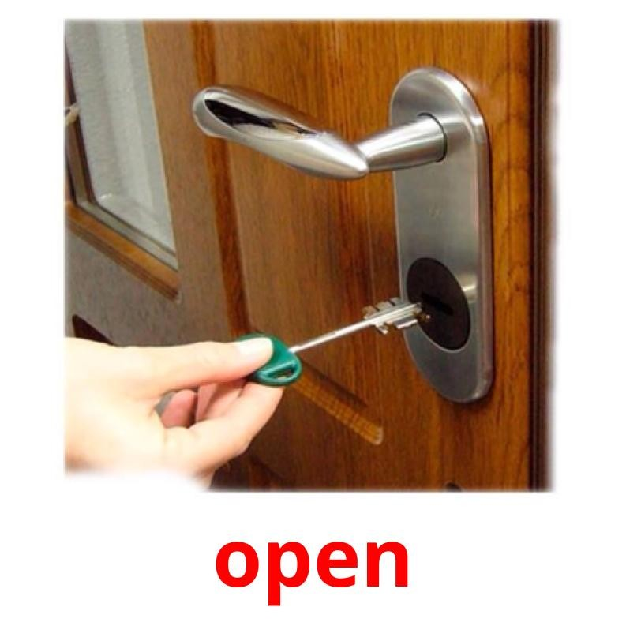
Action verbs - made by Kids-Flashcards.com

Slide 11
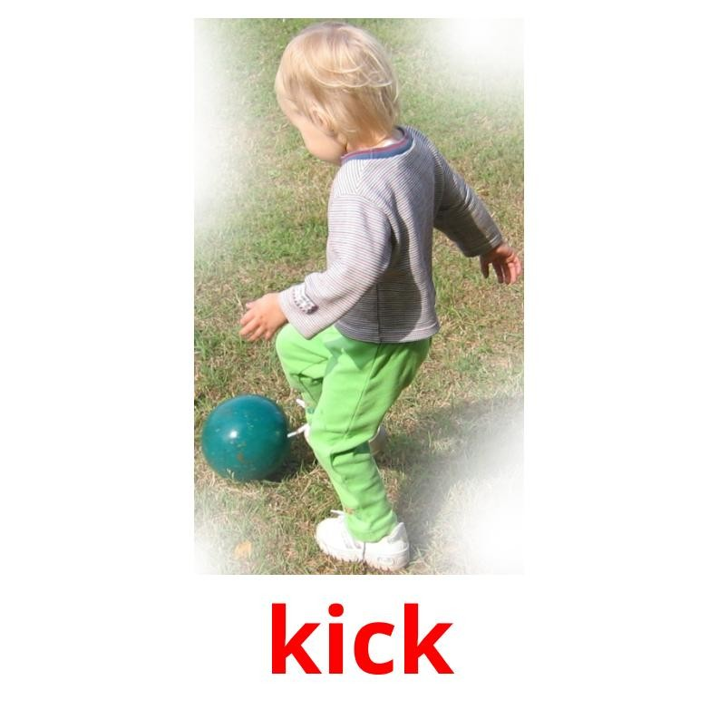
Action verbs - made by Kids-Flashcards.com

Slide 12
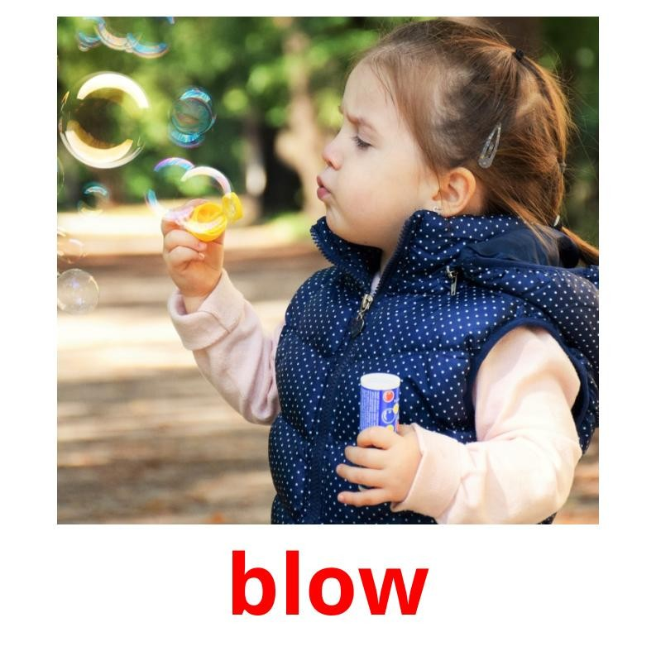
Action verbs - made by Kids-Flashcards.com

Slide 13
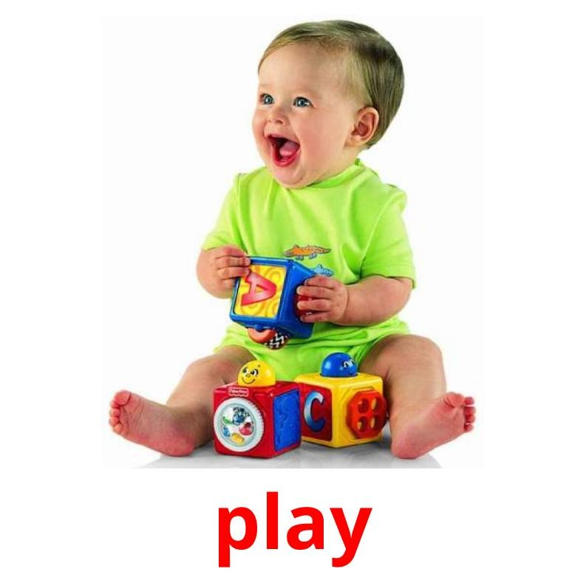
Action verbs - made by Kids-Flashcards.com

Slide 14
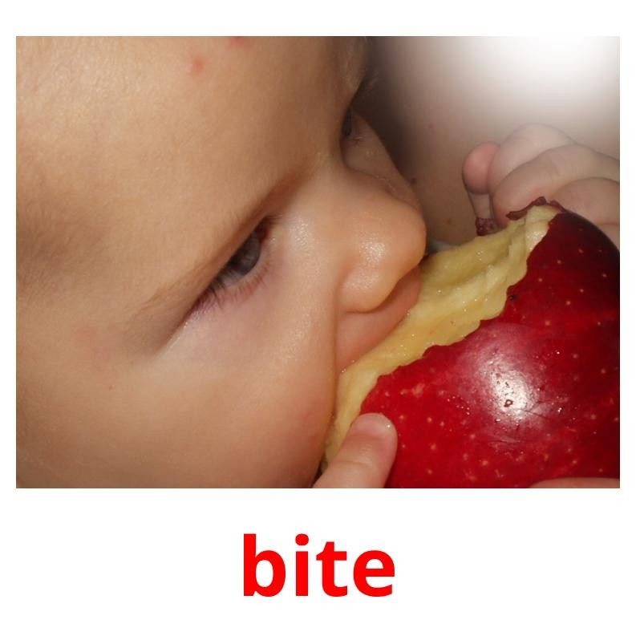
Action verbs - made by Kids-Flashcards.com

Slide 15
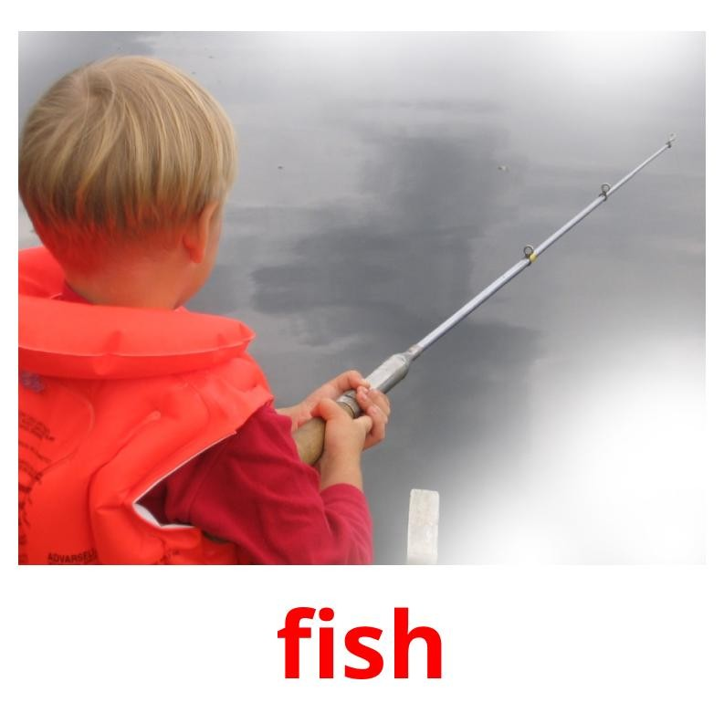
Action verbs - made by Kids-Flashcards.com

Slide 16
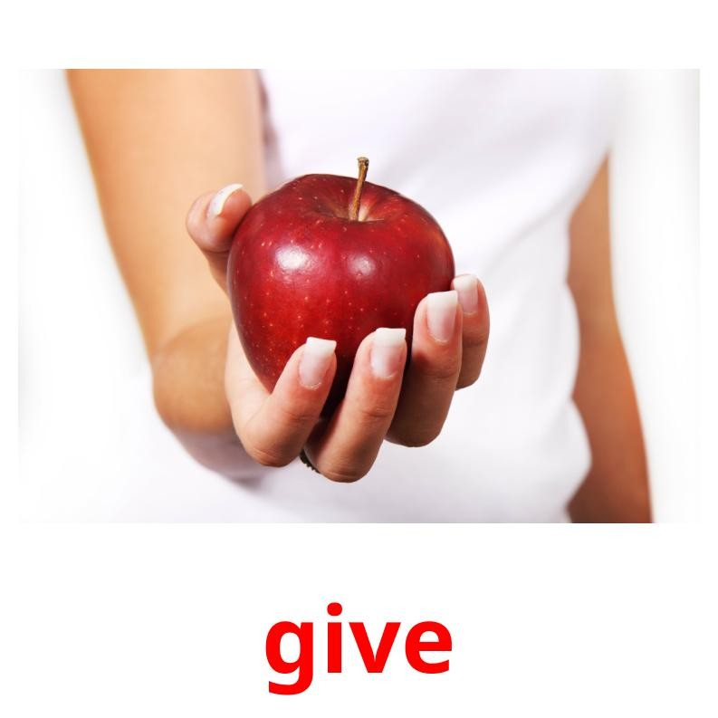
Action verbs - made by Kids-Flashcards.com

Slide 17
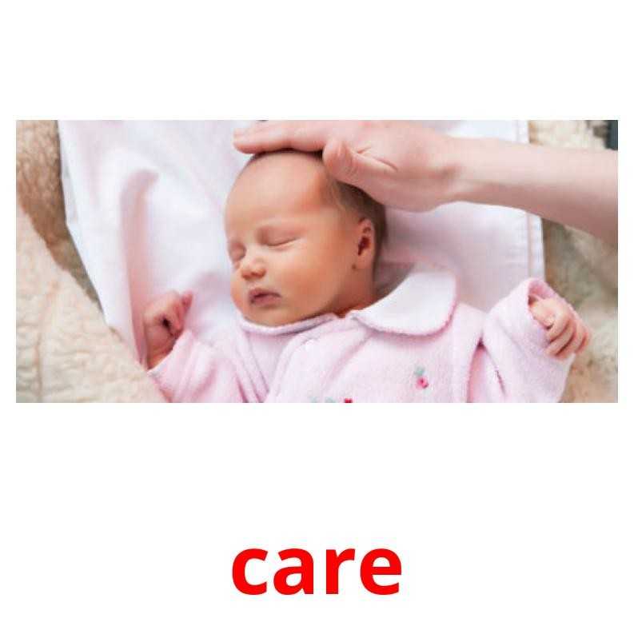
Action verbs - made by Kids-Flashcards.com

Slide 18
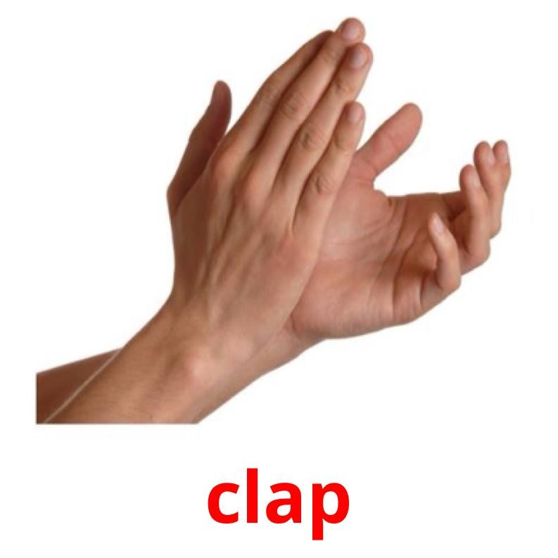
Action verbs - made by Kids-Flashcards.com

Slide 19
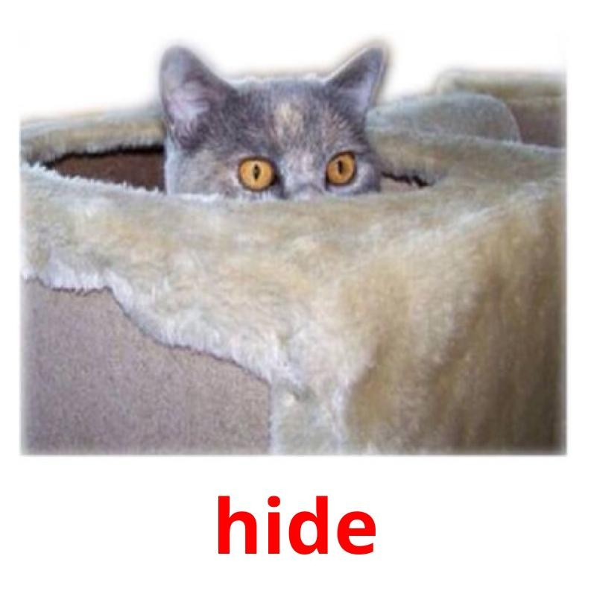
Action verbs - made by Kids-Flashcards.com

Slide 20
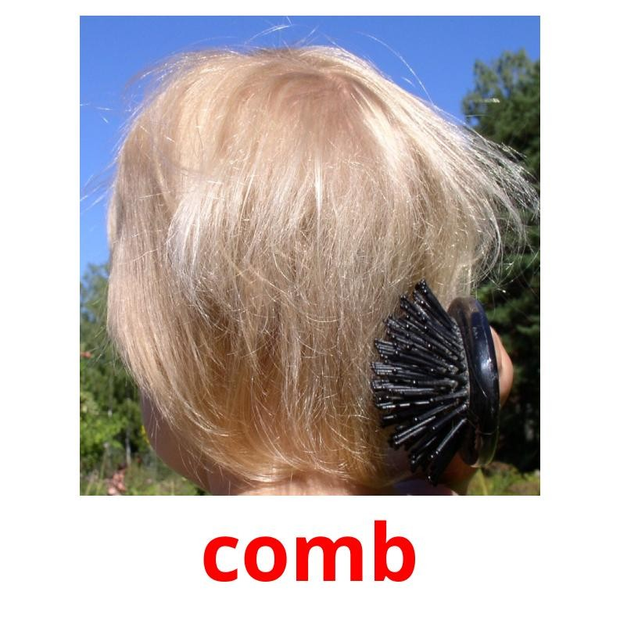
Action verbs - made by Kids-Flashcards.com

Slide 21
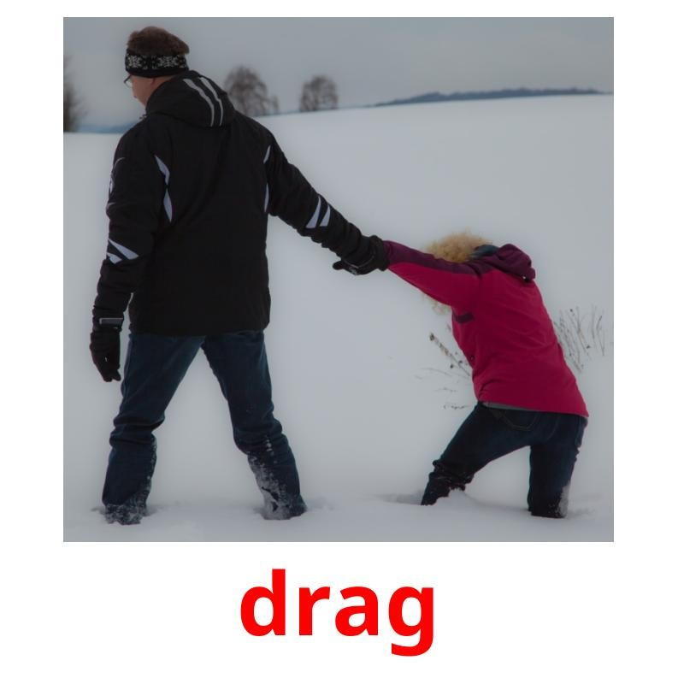
Action verbs - made by Kids-Flashcards.com

Slide 22
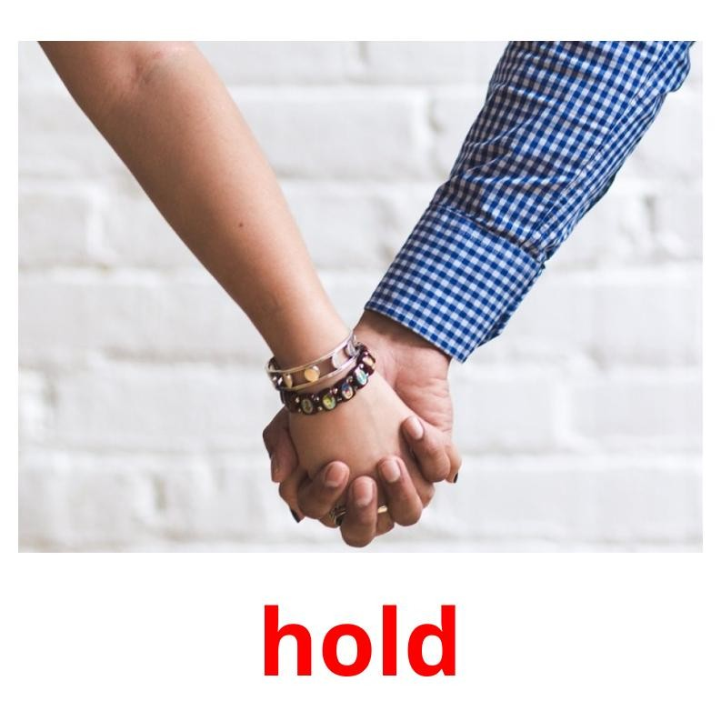
Action verbs - made by Kids-Flashcards.com

Slide 23
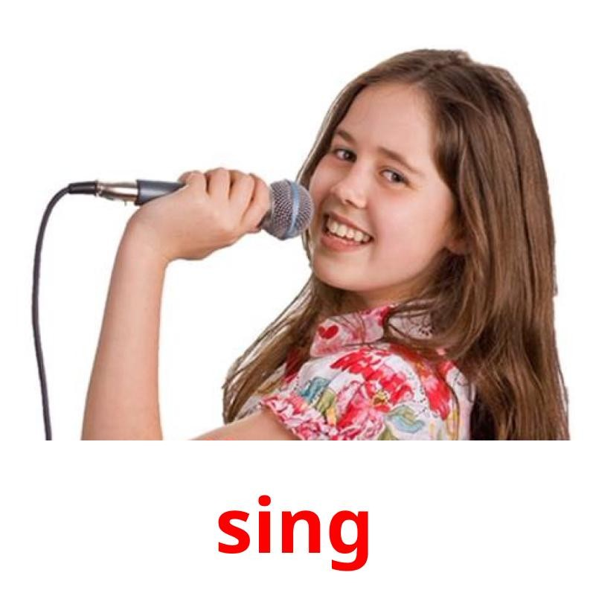
Action verbs - made by Kids-Flashcards.com

Slide 24

Action verbs - made by Kids-Flashcards.com

Slide 25
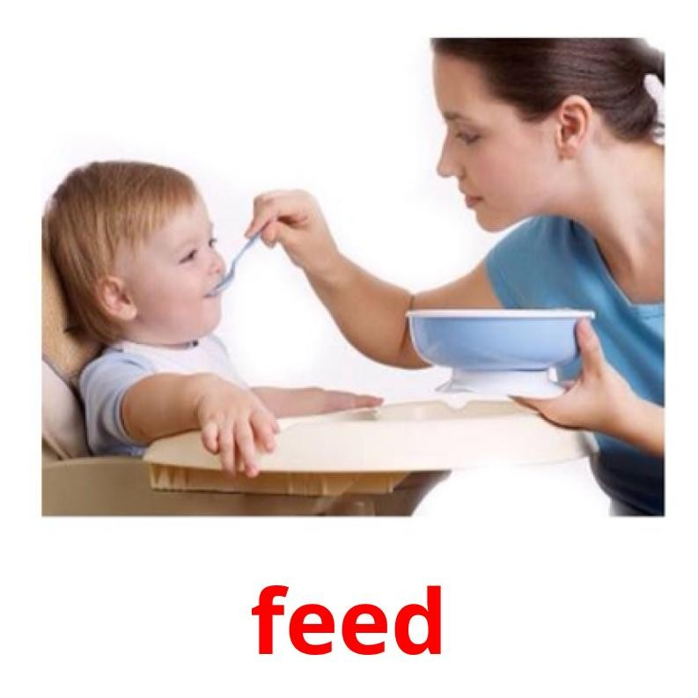
Action verbs - made by Kids-Flashcards.com

Slide 26
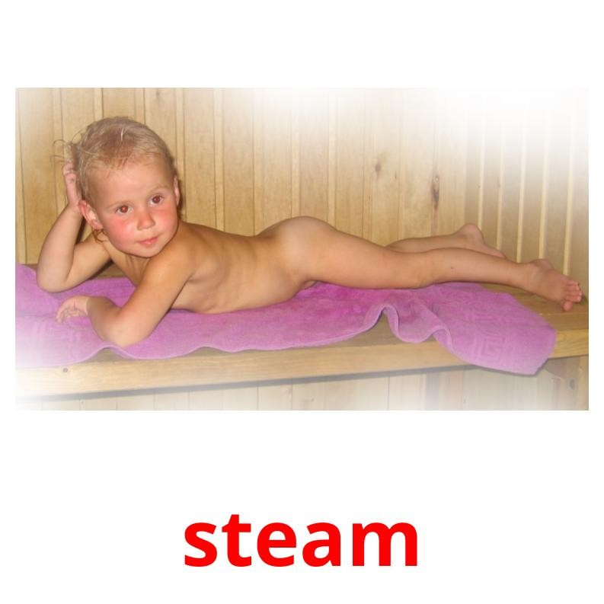
Action verbs - made by Kids-Flashcards.com

Slide 27
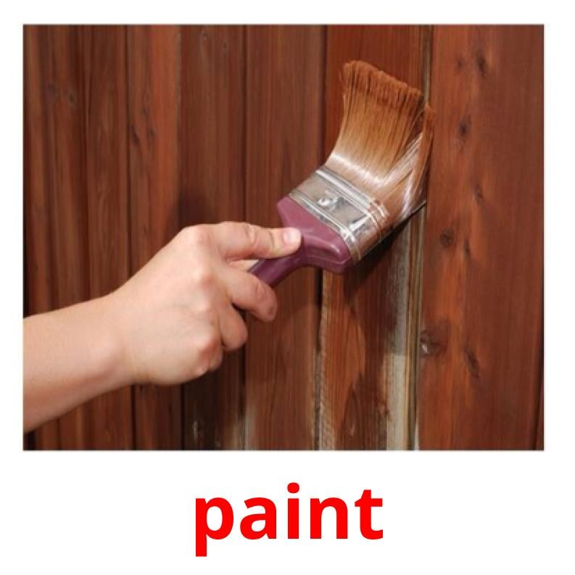
Action verbs - made by Kids-Flashcards.com

Slide 28
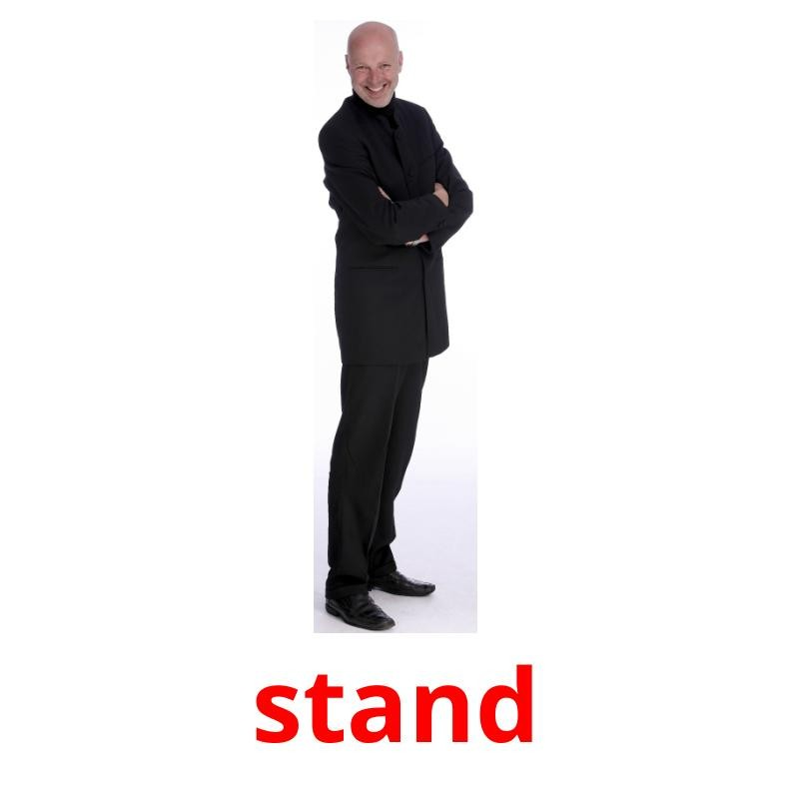
Action verbs - made by Kids-Flashcards.com

Slide 29

Action verbs - made by Kids-Flashcards.com

Slide 30
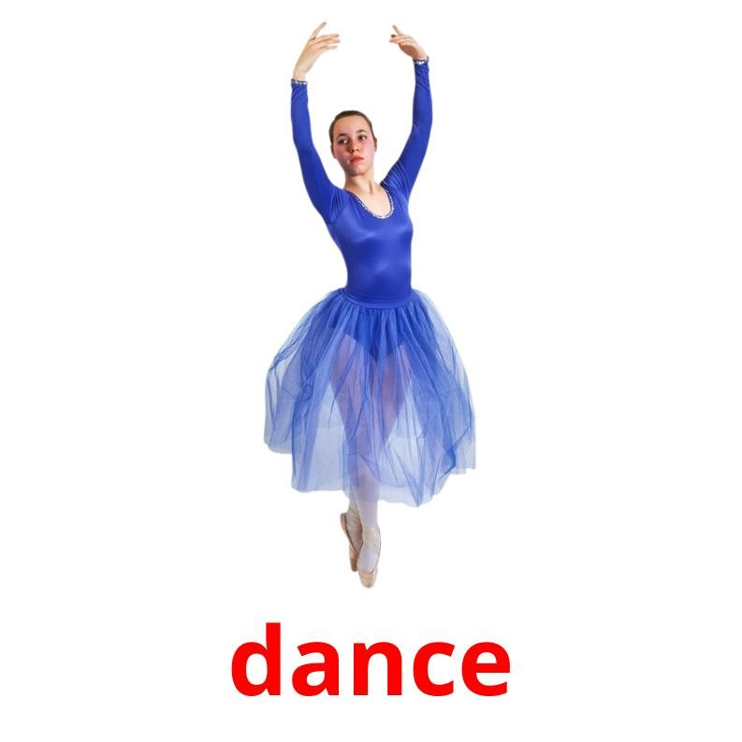
Action verbs - made by Kids-Flashcards.com

Slide 31
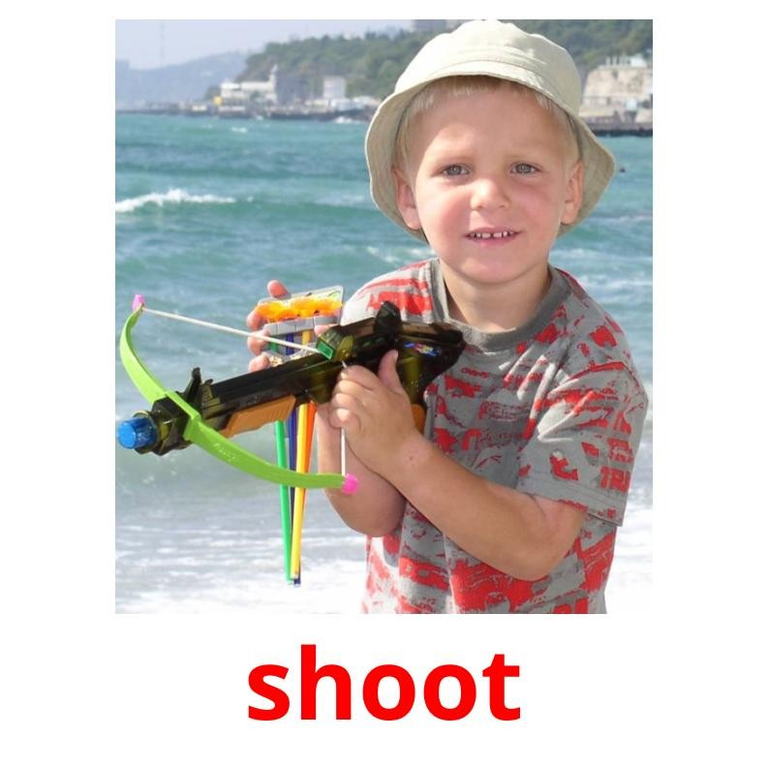
Action verbs - made by Kids-Flashcards.com

Slide 32
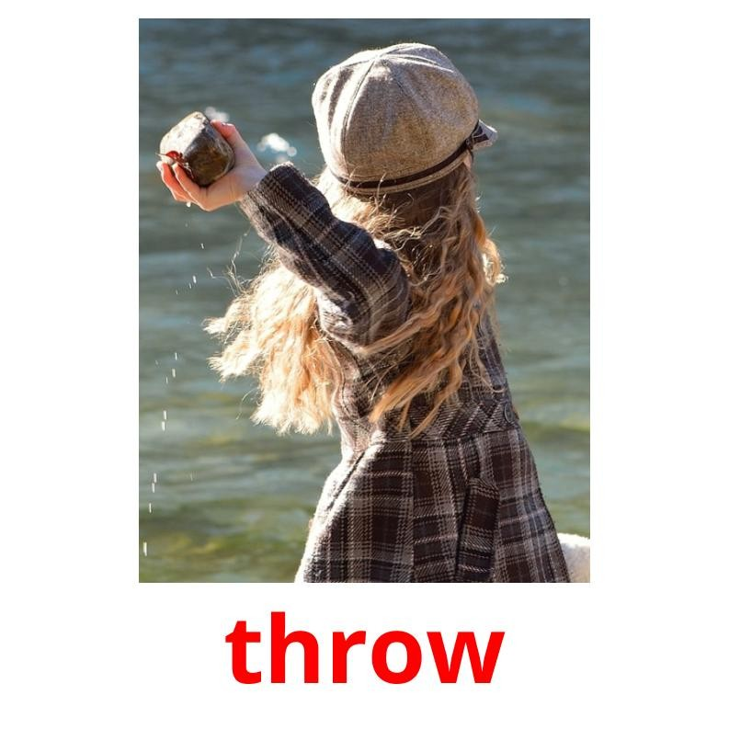
Action verbs - made by Kids-Flashcards.com

Slide 33
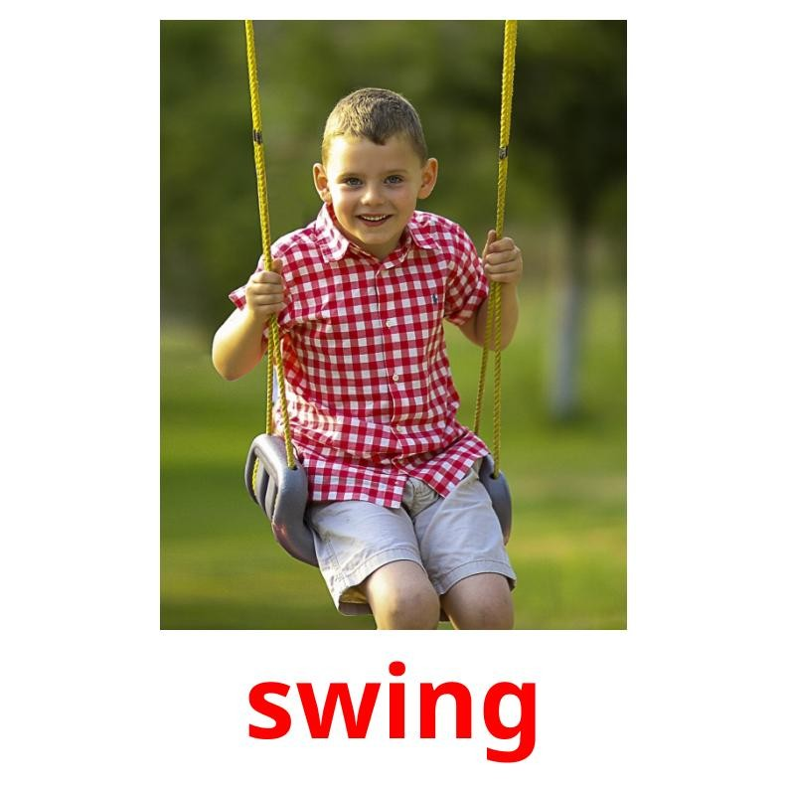
Action verbs - made by Kids-Flashcards.com

Slide 34
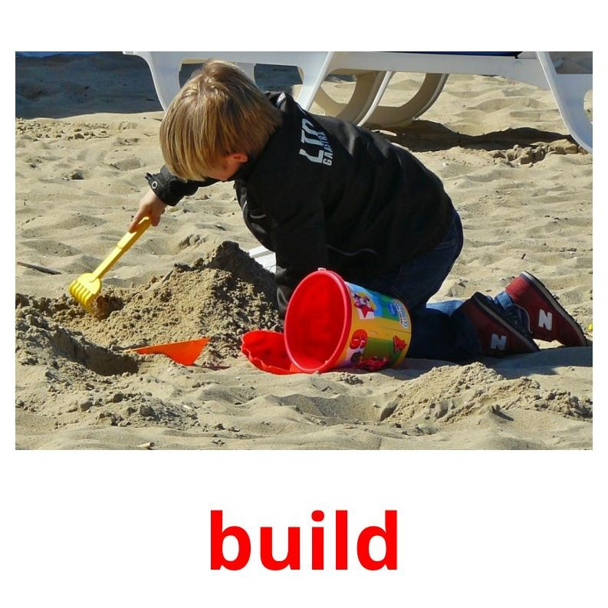
Action verbs - made by Kids-Flashcards.com

Slide 35
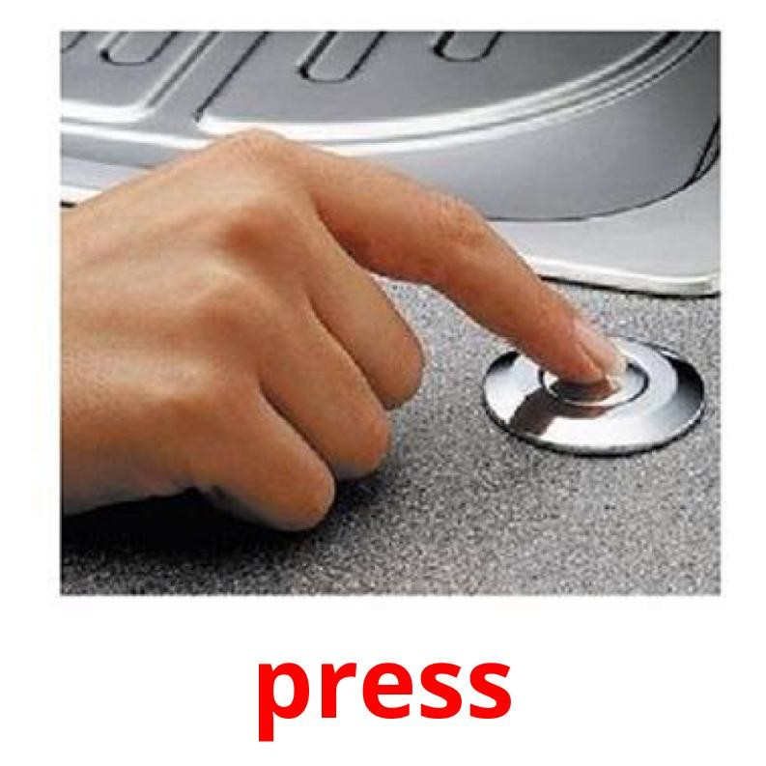
Action verbs - made by Kids-Flashcards.com

Slide 36
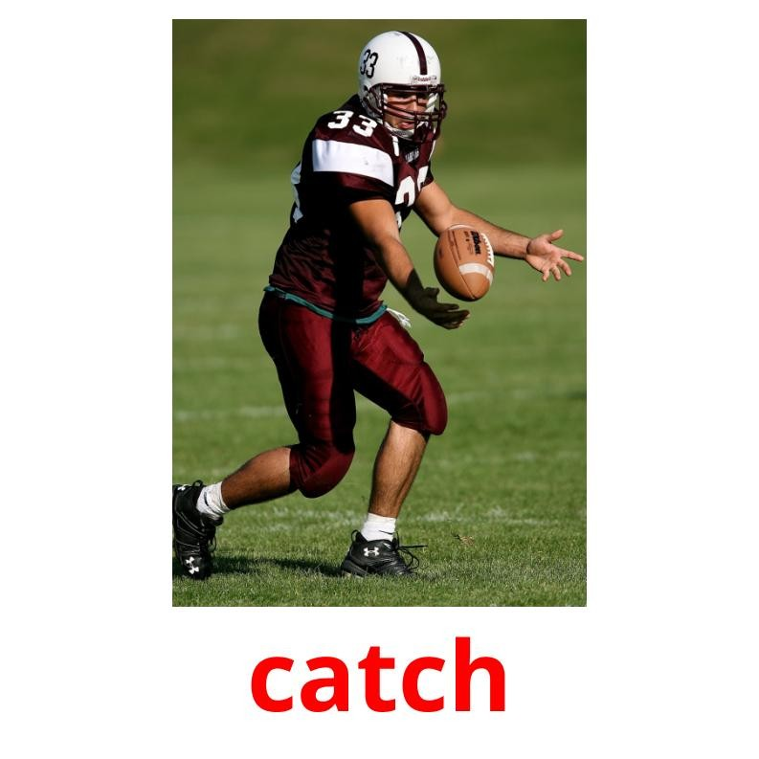
Action verbs - made by Kids-Flashcards.com

Slide 37
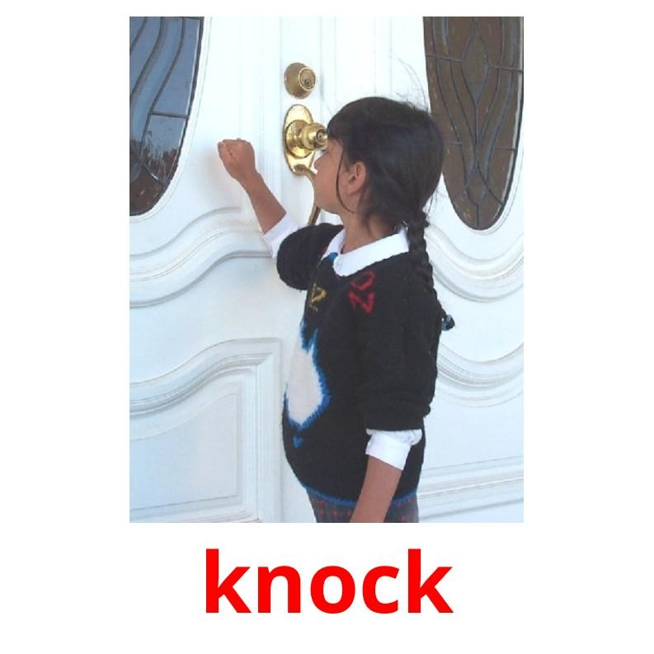
Action verbs - made by Kids-Flashcards.com

Slide 38
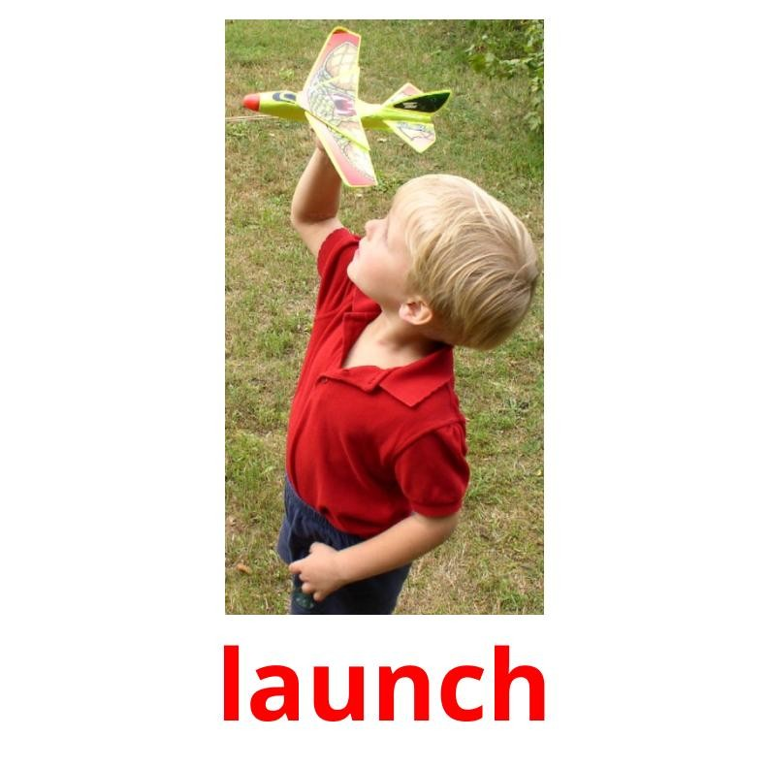
Action verbs - made by Kids-Flashcards.com

Slide 39
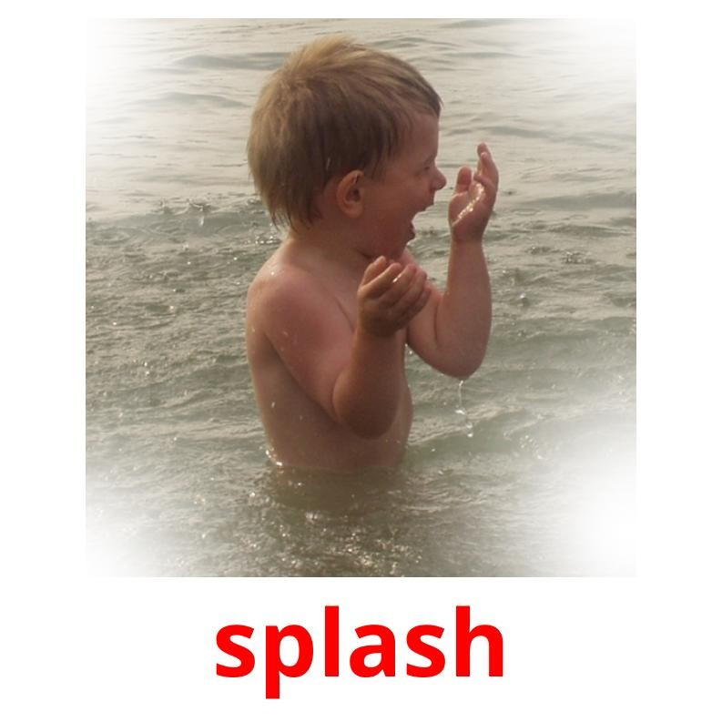
Action verbs - made by Kids-Flashcards.com

Slide 40
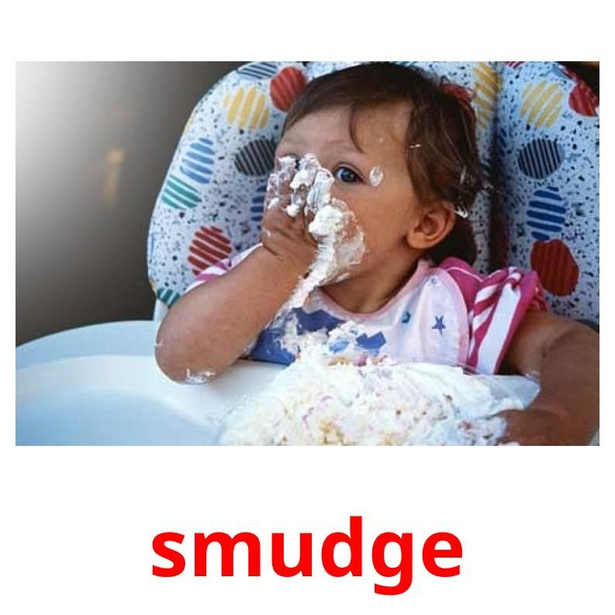
Action verbs - made by Kids-Flashcards.com

Slide 41

Action verbs - made by Kids-Flashcards.com

Slide 42
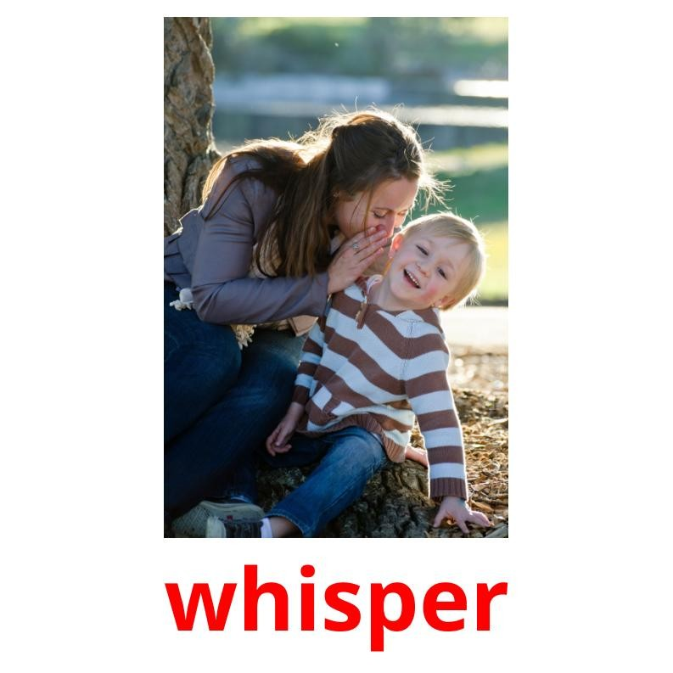
Action verbs - made by Kids-Flashcards.com

Slide 43
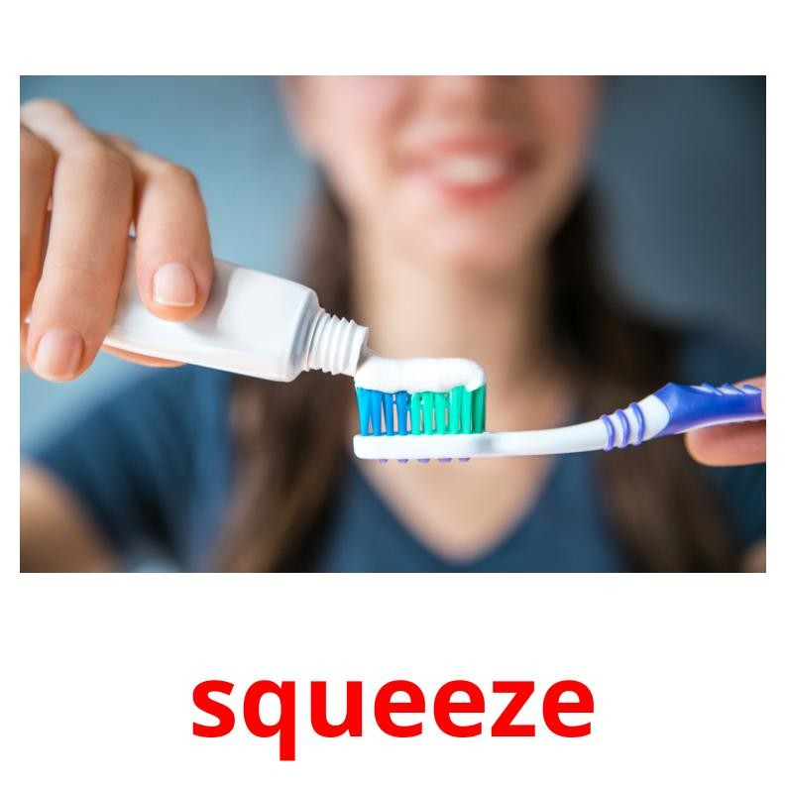
Action verbs - made by Kids-Flashcards.com

Slide 44
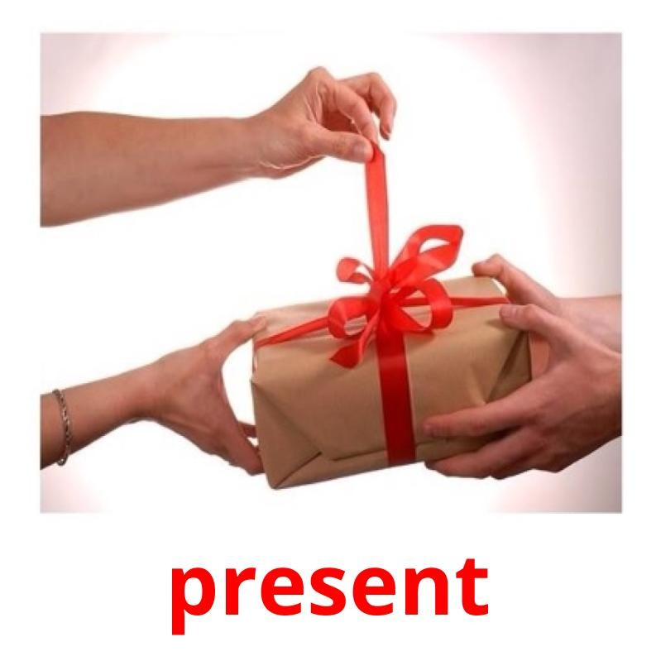
Action verbs - made by Kids-Flashcards.com

Slide 45
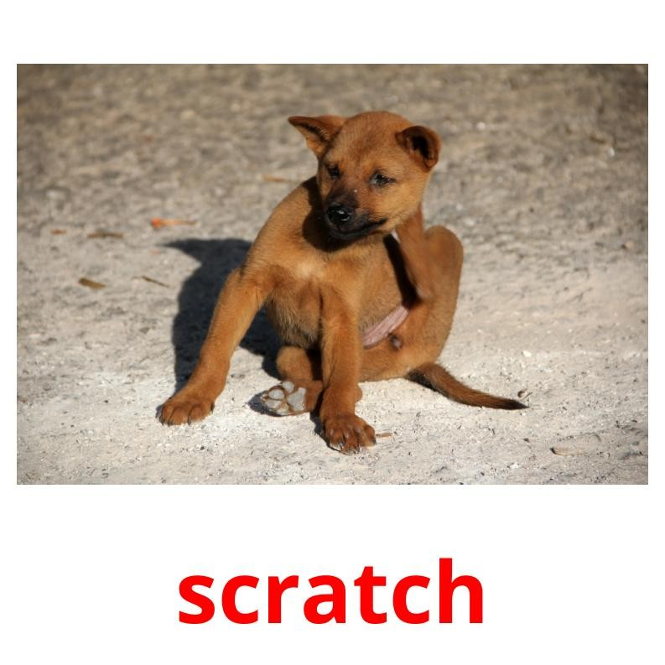
Action verbs - made by Kids-Flashcards.com

Slide 46
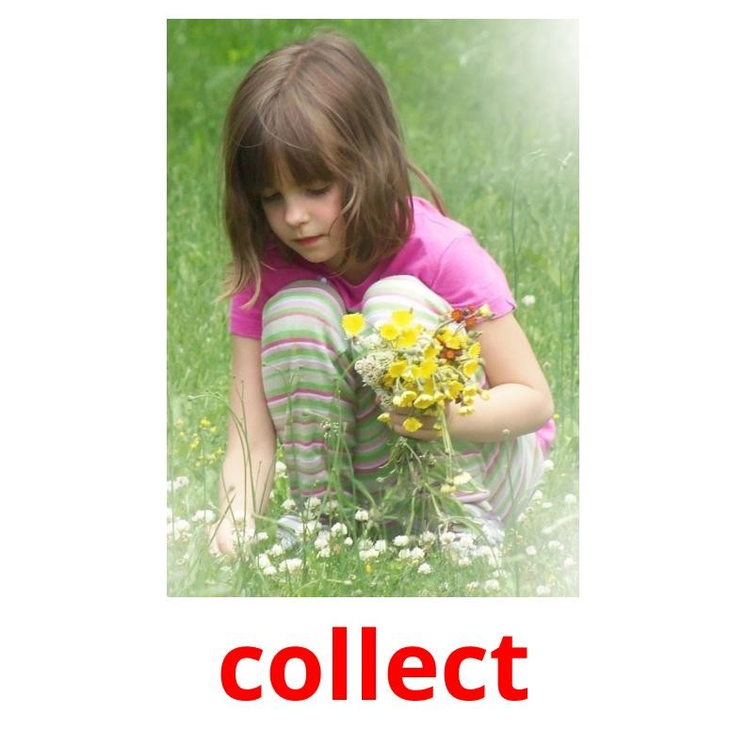
Action verbs - made by Kids-Flashcards.com

Slide 47
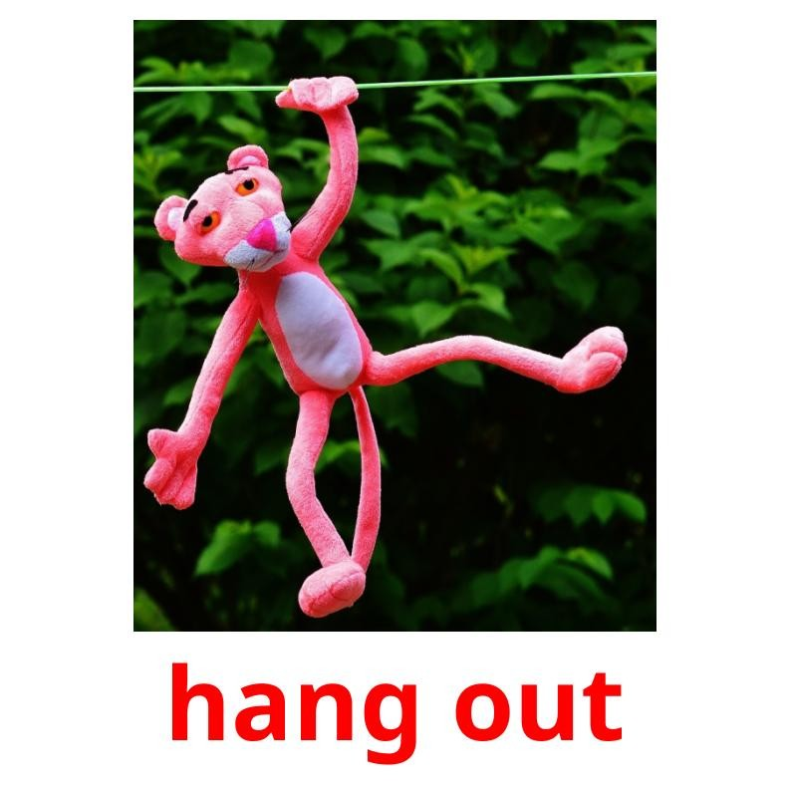
Action verbs - made by Kids-Flashcards.com

Slide 48
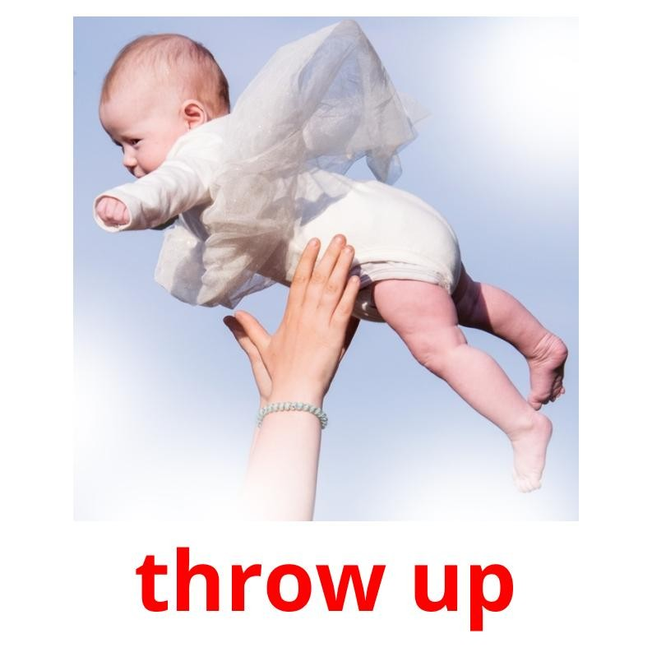
Action verbs - made by Kids-Flashcards.com

Slide 49
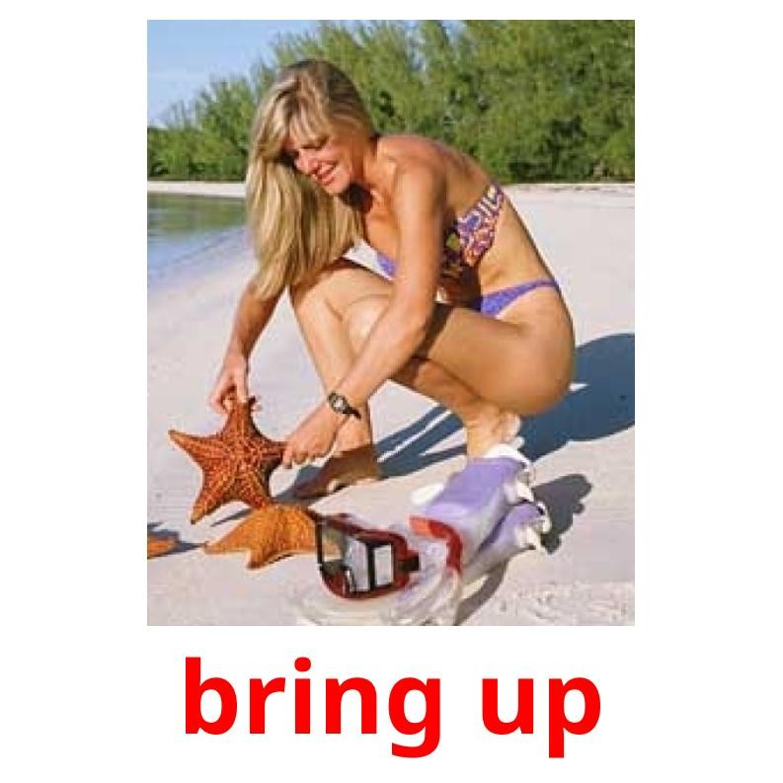
Action verbs - made by Kids-Flashcards.com

Slide 50
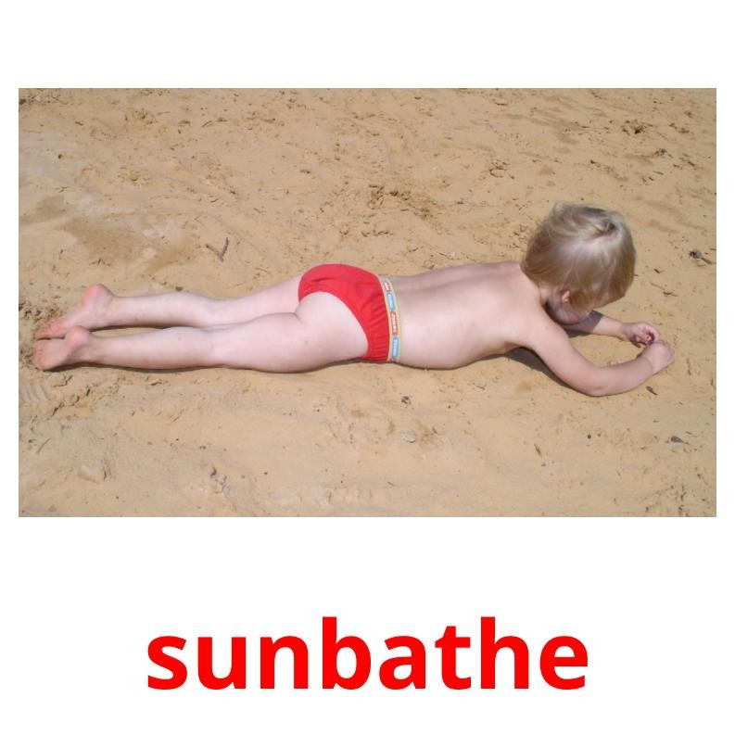
Action verbs - made by Kids-Flashcards.com

Slide 51
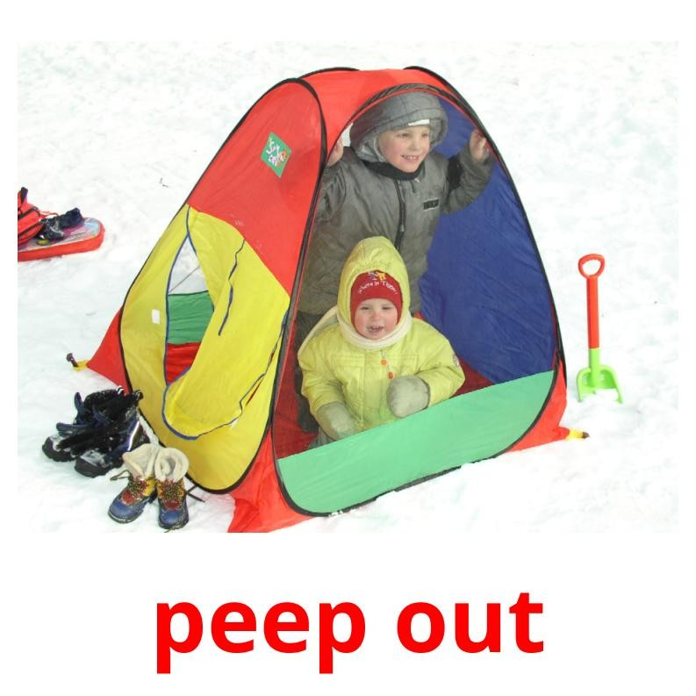
Action verbs - made by Kids-Flashcards.com

Slide 52
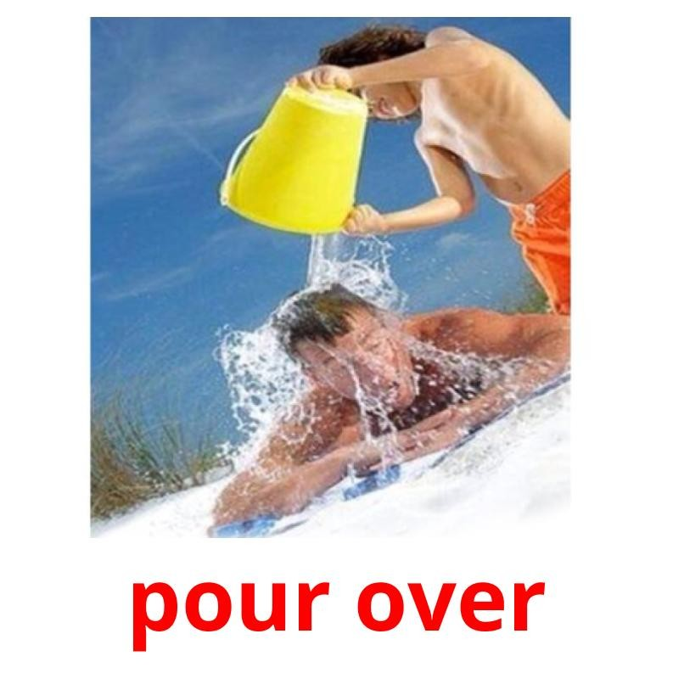
Action verbs - made by Kids-Flashcards.com

Slide 53
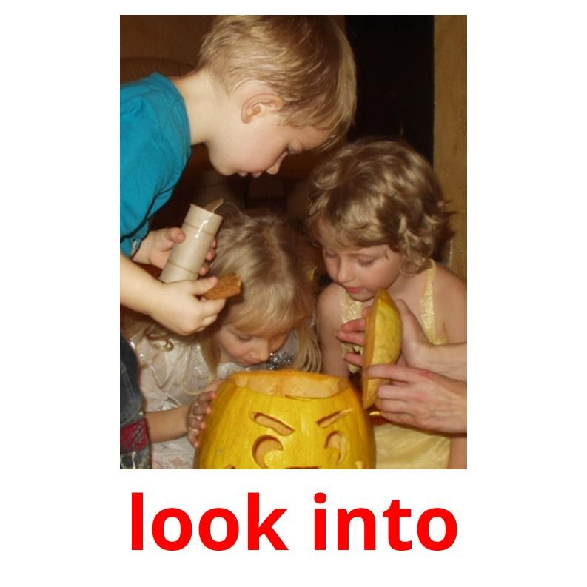
Action verbs - made by Kids-Flashcards.com

Slide 54
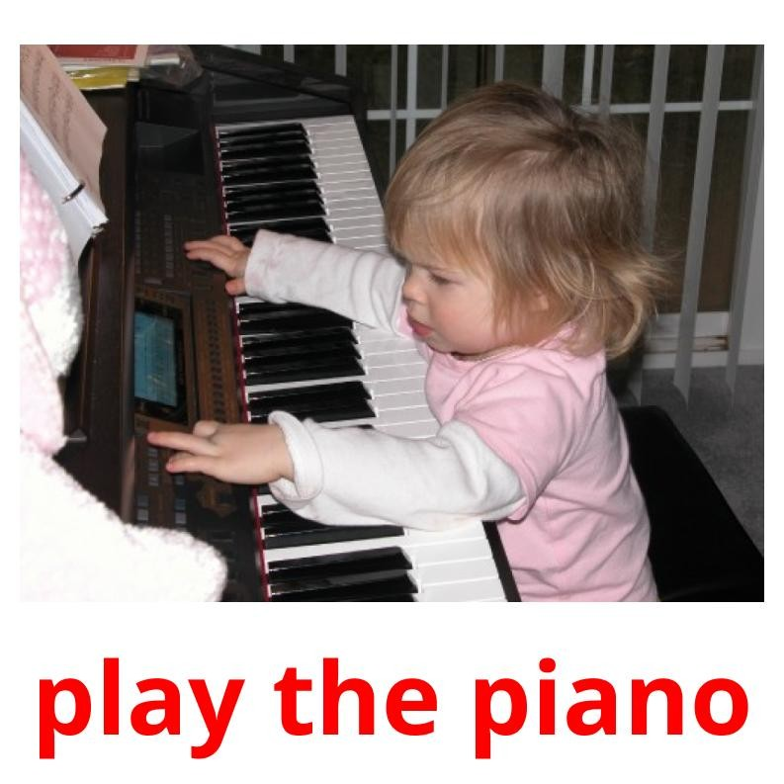
Action verbs - made by Kids-Flashcards.com

Slide 55

Action verbs - made by Kids-Flashcards.com

